Slide 1




Xilinx Open Hardware 2021 design contest
Implementation of Hummingbird Encryption Algorithm
Participants: Elie Cudkowicz & Itamar Yunnian
Team Number: xohw21-114
Supervisor: Uri Stroh

Slide 2

Do you want to close you house?

Slide 3

Your car?

Slide 4

Your vault?

Slide 5

But you don’t want to be carrying a lot of keys?

Slide 6

We got the solution! Use only one digital key encrypted with the lightweight Hummingbird-2 Algorithm

Slide 7

We implemented the Hummingbird-2 Encryption Algorithm on FPGA using:
Basys3 Board based on Artix7 FPGA
Arduino Nano Atmega 328P

Slide 8

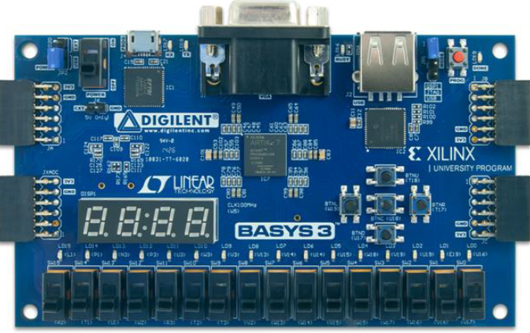
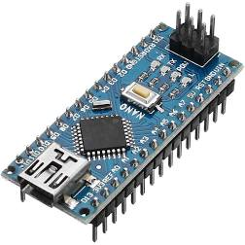
User enter:
1. Plaintext to be encrypted
2. Secret Key
3. Initial Vector to initialize the algorithm
Arduino
Send the data bit by bit to the Basys3 Board
Basys3
Compute the encrypted result (ciphertext)
Basys3
Send the ciphertext back to Arduino bit by bit
Arduino
Send the whole result back to the user
User
Display the ciphertext

Slide 9
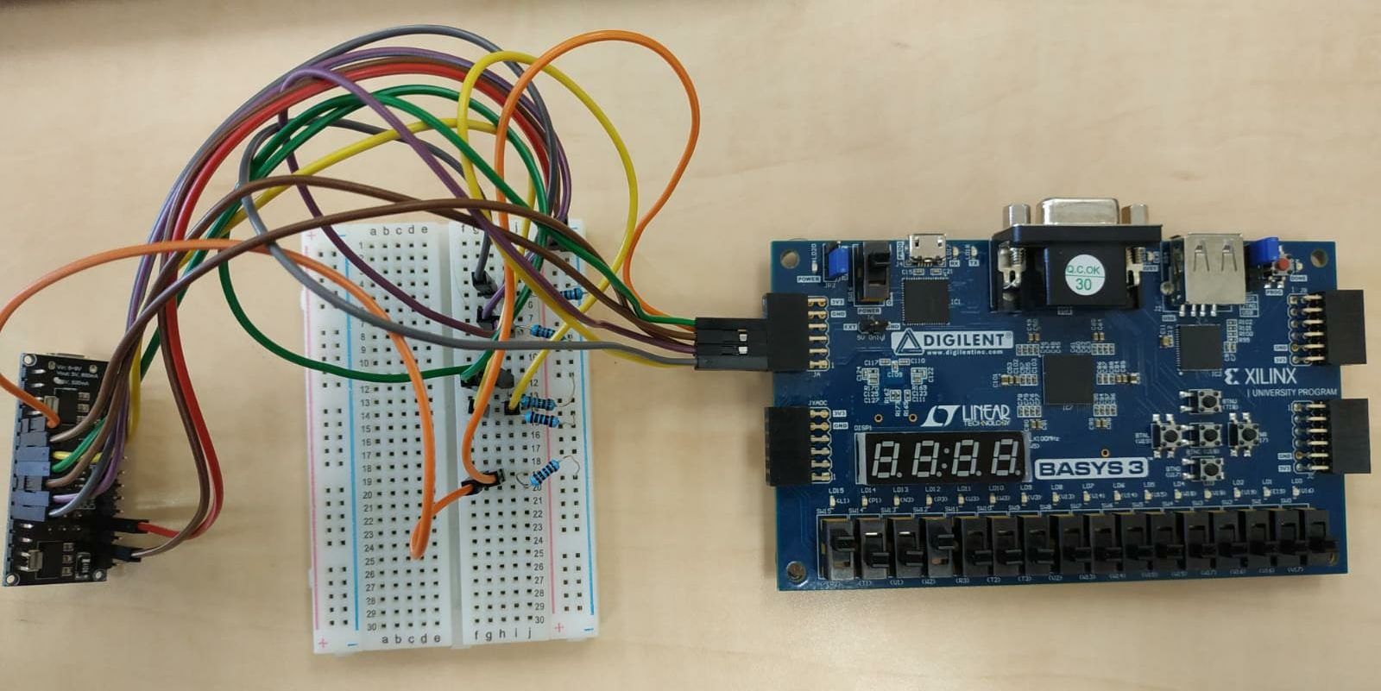
Data Flow
Plaintext + Key + IV

Slide 10
Data Flow
Ciphertext

Slide 11
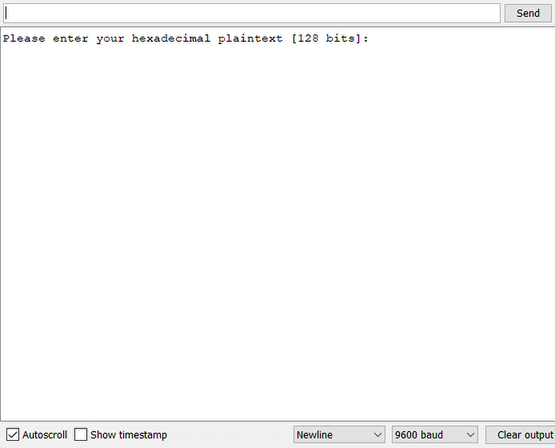
Hummingbird-2 running on Hardware

Slide 12
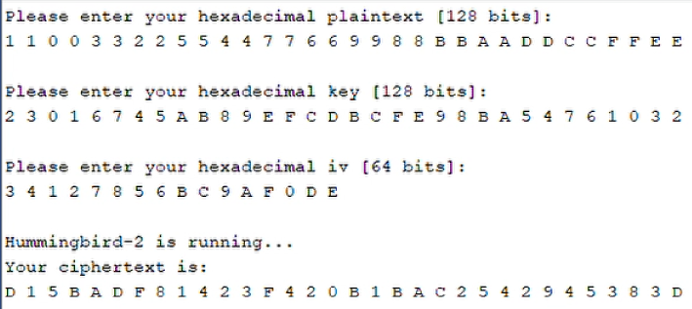
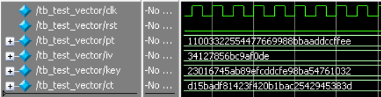
We see that the result on the Hardware is equal to the result on Simulation

Slide 13
Thanks for Watching!
For more information:
https://github.com/eliecudkowicz/Implementation-of-Hummingbird-Encryption-Algorithm
cudkowic@g.jct.ac.il
yunyan@g.jct.ac.il
Background music: Corona by Alexander Nakarada | https://www.serpentsoundstudios.com
Music promoted by https://www.chosic.com/
Attribution 4.0 International (CC BY 4.0)
https://creativecommons.org/licenses/by/4.0/

